Slide 1
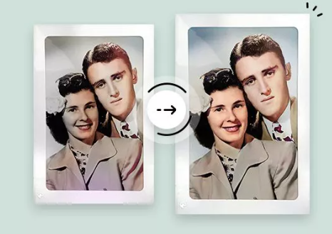
Enhancement Of Image Quality Resolution Using (CNN, Deep Learning) Team - 19
Student Details
Nikhitha Arumilli | 1002078974
Jyothi Bhavani Patibandla | 1001960841
Praneeth Bonagiri | 1002063572

Slide 2
Table of contents
Problem Statement
Dataset
Paper and Model
Architecture of the Model
Installations, enabling, importing
Implementation - Generator, Discriminator
Loss function
Testing Results & Discussion
Future work
Conclusion & References

Slide 3
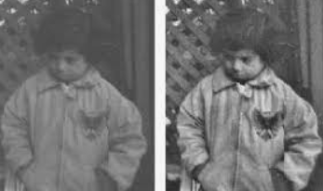
Problem Statement
● Restoring old black and white photographs to color images have been popular in recent days.
● A fully automatic approach is proposed that is able to produce realistic colorization of an input grayscale image.
● Image colorization process helps assigning colors to a grayscale image to make it more aesthetically appealing and perceptually meaningful.

Slide 4
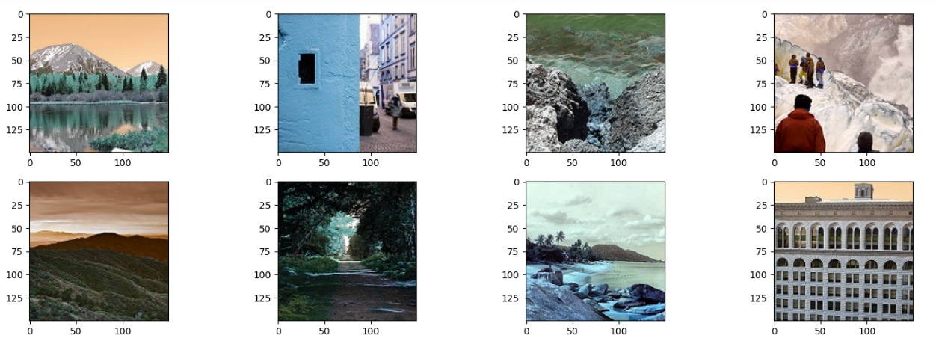
Subset of the Dataset: We are randomly selecting 100 classes with 100 images per class. So the size reduces to 10,000 images. The subset of ImageNet helps reduce space and time complexity.
DATASET IS FROM IMAGENET

Slide 5
REFERENCE PAPER
Colorization of Black and White Images Using Deep Learning by Abhishek Pandey, Rohit Sahay, C. Jayavarthini.
This paper deals with an automatic approach based on deep neural networks to colour the image in grayscale.
Method Used: VGG-16 CNN Model with CIE color space.
They are defining the problem of colorization as a CIE lab color space. It is about a 3-channel color
space that is L (intensity of lightness), a(green - red), b(blue - yellow).
The entire simplified mechanism can be summarized into four steps :
Convert all images in the RGB color space into the CIE lab color space.
Take the channel L as the input of the network by causing it to predict ab channels.
Associate the input channel L with expected ab channels.
Finally convert the lab image to the RGB color space using color space transforms.
Dataset Used: ImageNet and this algorithm works very well on images of scenes of animals and
outdoors.

Slide 6
ARCHITECTURE OF THE MODEL (Unet)
Generative Adversarial Networks(GAN)
GANs are a way to make a generative model by having two neural network compete with each other.
Generator
The generator turns noise into imitation of the data to try to trick discriminator.
Discriminator
The Discriminator tries to identify real data from fakes created by the generator.

Slide 7
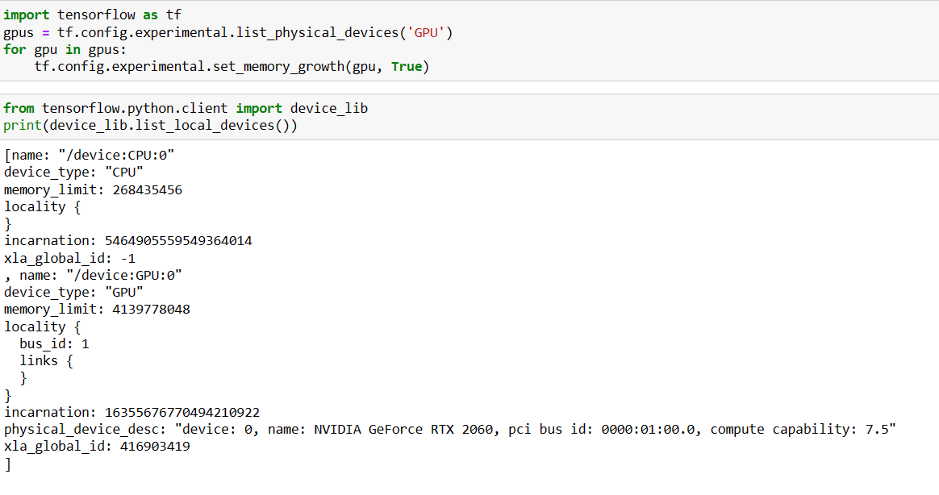
PREREQUISITE- ENABLED GPU

Slide 8
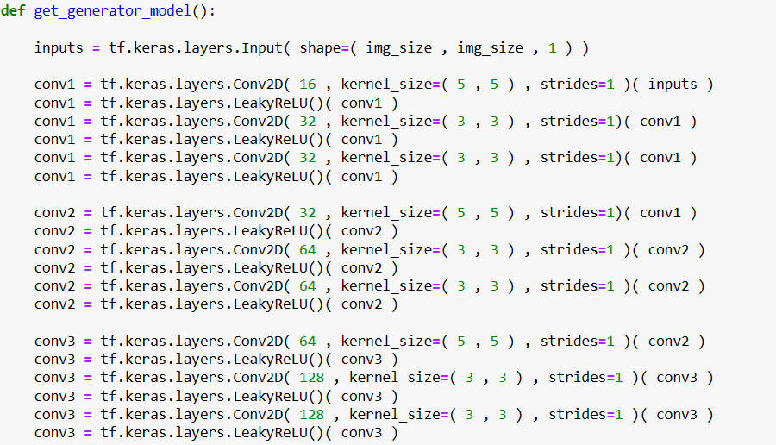
GENERATOR
Generator takes input image and generates synthetic image. We have used 3 convolutional 2d layer.
Our generator ( represented as 𝐺) will take in grayscale image 𝑥 and produce a RGB image 𝐺(𝑥).
𝑥 will be a tensor of shape ( 𝑏𝑎𝑡𝑐ℎ 𝑠𝑖𝑧𝑒 , 120 , 120 , 1 ) and the output 𝐺(𝑥) will have a shape ( 𝑏𝑎𝑡𝑐ℎ 𝑠𝑖𝑧𝑒 , 120 , 120 , 3 )
Our generator will have a encoder-decoder structure, similar to the UNet architecture. Additionally, we use Dilated convolutions to have a larger receptive field.
We introduce skip connections in our model so as to have better flow of information from the encoder to the decoder.

Slide 9
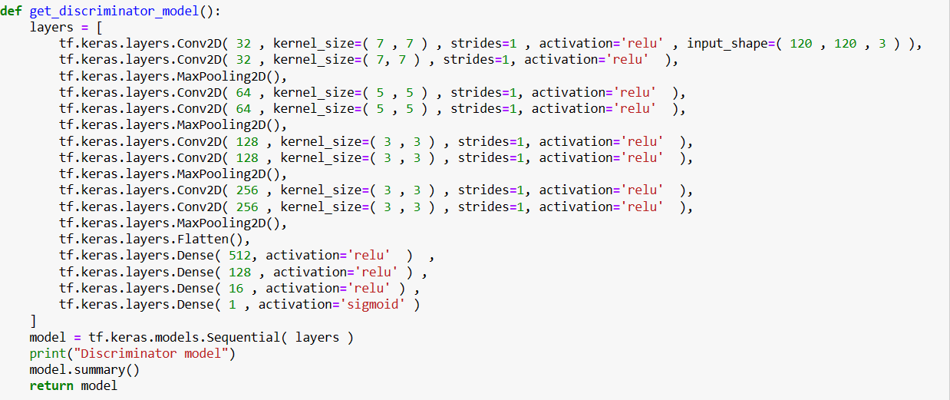
DISCRIMINATOR
We have used 4 convolutional 2d layer, with activation of relu.
The discriminator model, represented as 𝐷 , will take in the real image 𝑦( from the training data ) and the generated image 𝐺(𝑥)( from the generator ) to output two probabilities.
We train the discriminator in such a manner that is able to differentiate the real images and the generated images. So, we train the model such that 𝑦 produces a output of 1 and 𝐺(𝑥) produces an output of 0

Slide 10
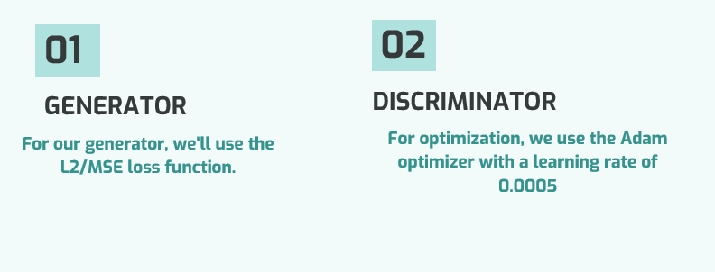
LOSS FUNCTION

Slide 11
Techniques used to improvise GAN performance
01
02
03
04
Used soft & Noisy labels
Used the Adam optimizer
Trained the discriminator
Avoided sparse gradient & used relu

Slide 12
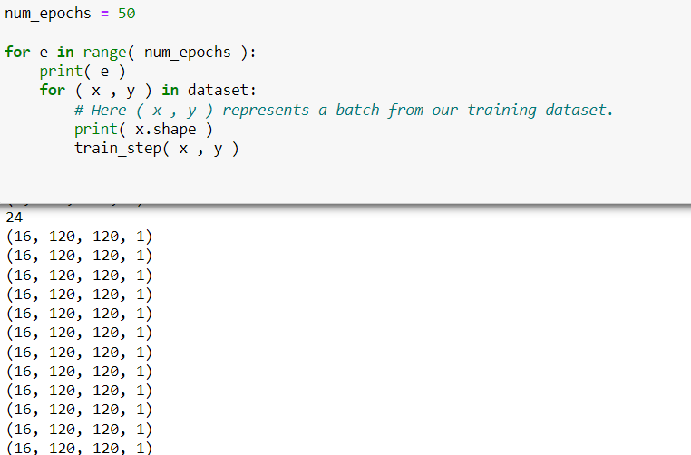
INSTANCE:
Epoch = 24
Total No of Epochs used:50
Batch size = 16
Image size = 120
Image= coloured instance

Slide 13
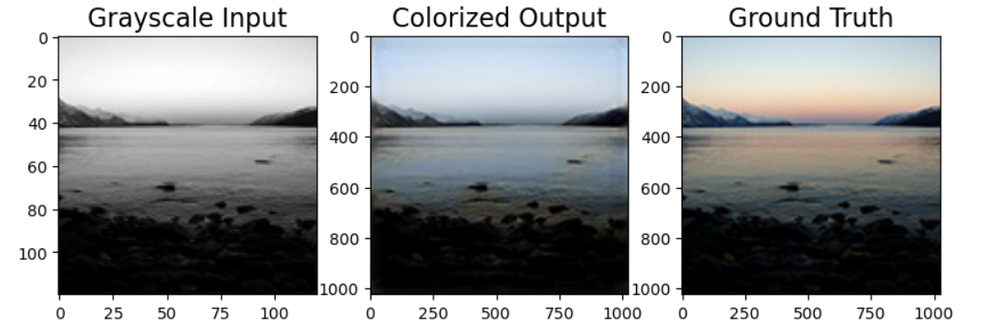
OUTPUT

Slide 14
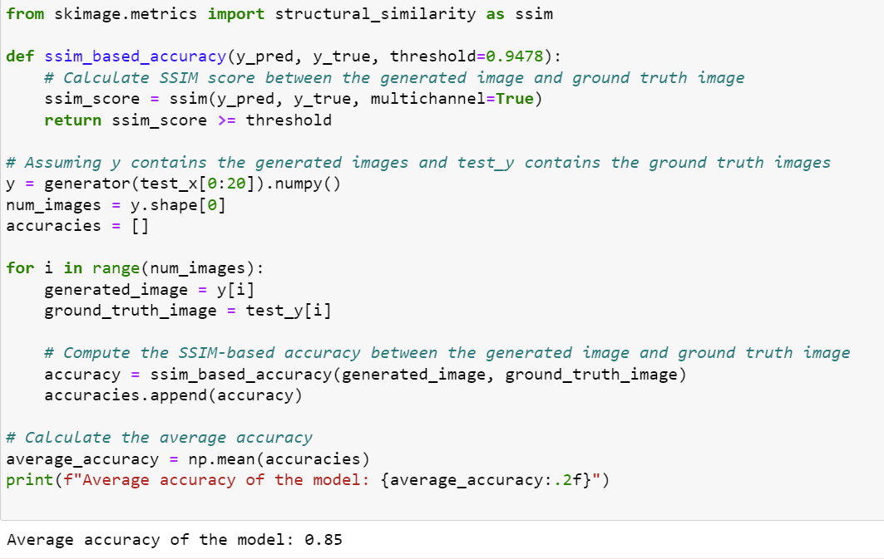
Accuracy
Based on the scores of SSIM we have taken those average scores and set up a threshold for filtering out colorized images that don't meet a certain quality level. While SSIM measures similarity between the generated and ground truth images, the threshold-based accuracy compares pixel-wise differences.finally we have got an accuracy of 85% for the considerable amount of 50 epochs data.

Slide 15
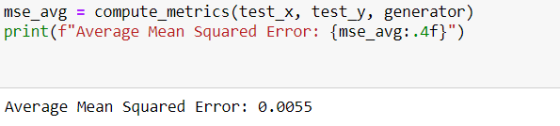
Mean Square Error(MSE)
MSE is calculated by squaring the differences between predicted and actual values, it can grow substantially for large errors.

Slide 16
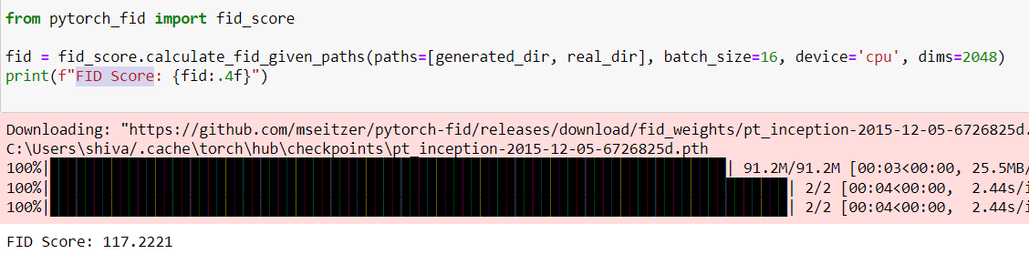
The range of the Fréchet Inception Distance (FID) score theoretically lies between 0 and positive infinity. A lower FID score indicates that the generated images are more similar to the real images, both in terms of quality and diversity.
FID SCORE

Slide 17
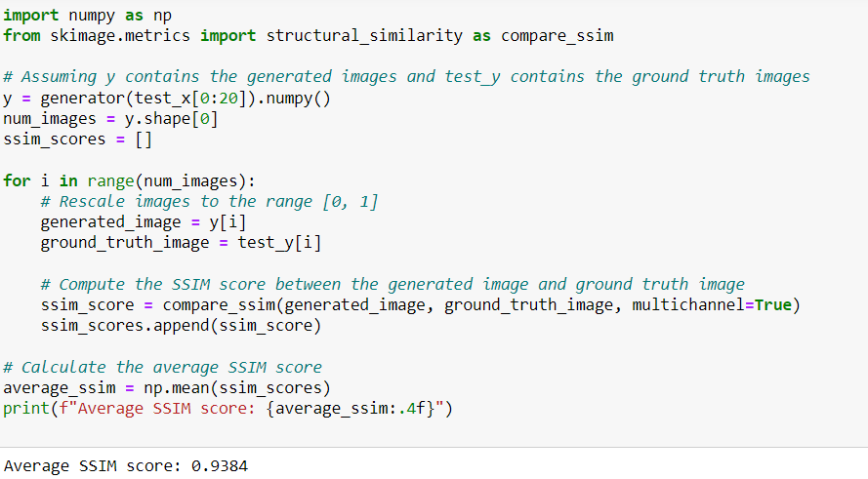
SSIM SCORE
SSIM score of 0.9384 is generally considered to be a good score, as it is close to 1, which indicates that the images are identical.

Slide 18
Difference in approach between our project and the main projects of our references
In our reference paper, they used VGG16 for the colorization of images their approach was to Convert all training images from the RGB color space to the Lab color space. where they Use the L channel as the input to the network and train the network to predict the ab channels and Combine the input L channel with the predicted ab channels. finally, they Convert the Lab image back to RGB
In our Project, we have implemented GAN consisting of a generator model and a discriminator model. The generator model takes grayscale images as input and generates colorized images. The discriminator model classifies whether an image is a real (ground truth) or generated (colorized by the generator) image. The generator and discriminator models are trained together, where the generator learns to produce more realistic colorized images, and the discriminator becomes better at distinguishing between real and generated images

Slide 19
Future Work
As of now, we Implemented solutions for the colorization of images and their enhancement. similarly, colorization videos can also be done, though it is complex we achieve it by overcoming computational power and better optimization algorithms can be used.

Slide 20
Challenges
Computing Huge dataset.
- Enabled GPU and CPU to sort this problem and considered only the subset of dataset is considered.
Very high Training time.
- Considered only 50 Epochs of data.
Choosing the best optimizer
- we have used Adam optimizer.

Slide 21
References
The following papers served as the primary sources for this project:
Convolutional Neural Networks for automatic image colorization by Domonkos Verga and Tamas Sziranyi.(VGG-16)
https://eprints.sztaki.hu/9292/1/Varga_1_3306455_ny.pdf
Automatic Image Colorization using Deep Learning by Abhishek Pandey, Rohit Sahay, C.Jayavarthini
https://www.researchgate.net/publication/339468315_Grayscale_images_colorization_with_convolutional_neural_networks
Automatic Image Colorization with Convolutional Neural Networks and Generative Adversarial Networks.
https://web.eecs.umich.edu/~justincj/teaching/eecs442/projects/WI2021/pdfs/068.pdf
RGB to Lab Transformation Using Image Segmentation
https://www.academia.edu/29593488/RGB_to_Lab_Transformation_Using_Image_Segmentation
Fully Automatic Image Colorization Based On Convolutional neural network by Domonkos Varga, Tamas Sziranyi
https://ieeexplore.ieee.org/document/7900208

Slide 22
THANKYOU!!☺

